Slide 1

IT 334 – DevOps Engineering on AWS Cloud
Project – Building a Highly Available, Scalable Web Application
Group 12: Elma Sarajlić Merima Maksumić
Date: 14.06.2024.
Teacher: Dženana Dževlan

Slide 2
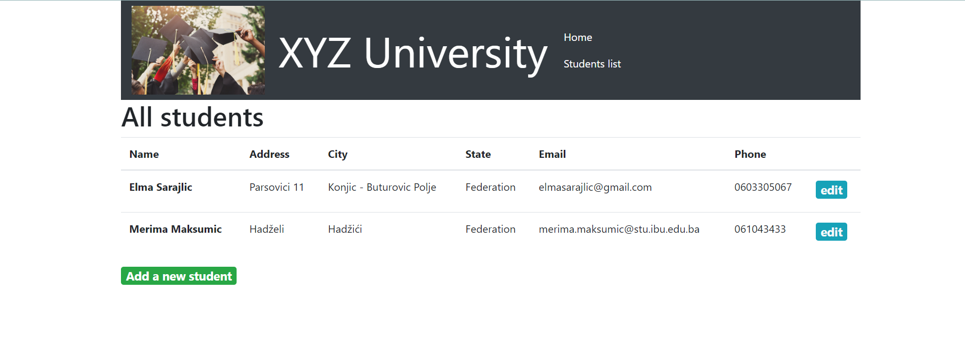
Business scenario overview
Problem or opportunity statement.
XYZ University has received complaints about the web application's performance and availability during peak admissions periods.
Our task was to provide a cost-effective, highly available, and scalable web application that needs to support thousands of users simultaneously and maintain high performance and availability.
Notes:
You can also go more in depth about the design considerations and trade-offs that you made.

Slide 3
Business scenario overview
Solution requirements:
Functional: View, add, delete, and modify student records without delay.
Load balanced: Properly distribute user traffic.
Scalable: Meet high demand during peak periods.
Highly available: Minimal downtime.
Secure: Database secured, appropriate network security settings, and can be accessed only over the appropriate ports.
Cost optimized: Keep costs low.
High performing: Routine operations without perceivable delay.
Notes:
You can also go more in depth about the design considerations and trade-offs that you made.

Slide 4
Solution overview
Planning the design and estimating cost
Creating a basic functional Web Application
Decoupling the application components
Implementing High Aviailability and Scalability
Digrams AWS Pricing Calculator
Vpc Two AZ‘s Two instances EC2 Securtity group Internet Gateway Nat Gateway
Amazon RDS Cloud9 Secrets Manager Migration of Database
Application Load Balancer Auto Scalling Group
Notes:
Explain at a high level what you have built.
For example: “I built a web application for a company to host their blog.“
Talk about why you chose certain parts of the solutions and any tradeoffs that you made. Focus on how you designed the solutions and how you applied the AWS Well-Architected Framework as part of the process (AWS Well-Architected Framework: https://docs.aws.amazon.com/wellarchitected/latest/framework/welcome.html).
For example: “I configured load balancers and auto scaling to make the application highly available and reliable.”
Include the use cases that you are addressing. Think about who your users are and how they would want to interact with your solution to solve their problem.
For example: “Users can view, upload, edit, and delete blog posts. Administrators can approve blog posts.”
Talk about the use cases that you addressed as part of the minimum viable product (MVP) that you scoped and built.
Note:
An above-bar description is concise and includes the most important benefits. For example: “The solution allows customers to quickly upload, store, and search large catalogs of images and videos in Amazon S3.”
A below-bar description is too detailed or not specific. For example: “Our solution analyzes media files.”

Slide 5
Solution overview
Configure Route Tables
Enable Auto-Assign Public IPv4 on Public Subnet 1
Creating a basic functional Web Application
Planning the design and estimating cost
Decoupling the application components
Implementing High Aviailability and Scalability
Enable DNS hostnames for VPC
Diagrams AWS Pricing Calculator
Vpc Two AZ‘s Two instances EC2 Securtity group Internet Gateway Nat Gateway
Amazon RDS Cloud9 Secrets Manager Migration of Database
Application Load Balancer Auto Scaling Group
Notes:
Explain at a high level what you have built.
For example: “I built a web application for a company to host their blog.“
Talk about why you chose certain parts of the solutions and any tradeoffs that you made. Focus on how you designed the solutions and how you applied the AWS Well-Architected Framework as part of the process (AWS Well-Architected Framework: https://docs.aws.amazon.com/wellarchitected/latest/framework/welcome.html).
For example: “I configured load balancers and auto scaling to make the application highly available and reliable.”
Include the use cases that you are addressing. Think about who your users are and how they would want to interact with your solution to solve their problem.
For example: “Users can view, upload, edit, and delete blog posts. Administrators can approve blog posts.”
Talk about the use cases that you addressed as part of the minimum viable product (MVP) that you scoped and built.
Note:
An above-bar description is concise and includes the most important benefits. For example: “The solution allows customers to quickly upload, store, and search large catalogs of images and videos in Amazon S3.”
A below-bar description is too detailed or not specific. For example: “Our solution analyzes media files.”

Slide 6
Solution overview
Provision a new istnace for Web Server
Decoupling the application components
Planning the design and estimating cost
Creating a basic functional Web Application
Implementing High Aviailability and Scalability
Crete a database subnet group
Diagrams AWS Pricing Calculator
Vpc Two AZ‘s Two instances EC2 Securtity group Internet Gateway Nat Gateway
Amazon RDS Cloud9 Secrets Manager Migration of Database
Application Load Balancer Auto Scaling Group
Notes:
Explain at a high level what you have built.
For example: “I built a web application for a company to host their blog.“
Talk about why you chose certain parts of the solutions and any tradeoffs that you made. Focus on how you designed the solutions and how you applied the AWS Well-Architected Framework as part of the process (AWS Well-Architected Framework: https://docs.aws.amazon.com/wellarchitected/latest/framework/welcome.html).
For example: “I configured load balancers and auto scaling to make the application highly available and reliable.”
Include the use cases that you are addressing. Think about who your users are and how they would want to interact with your solution to solve their problem.
For example: “Users can view, upload, edit, and delete blog posts. Administrators can approve blog posts.”
Talk about the use cases that you addressed as part of the minimum viable product (MVP) that you scoped and built.
Note:
An above-bar description is concise and includes the most important benefits. For example: “The solution allows customers to quickly upload, store, and search large catalogs of images and videos in Amazon S3.”
A below-bar description is too detailed or not specific. For example: “Our solution analyzes media files.”

Slide 7
Solution overview
Create Target Groups
Create Image from Instance2
Implementing High Aviailability and Scalability
Planning the design and estimating cost
Creating a basic functional Web Application
Decoupling the application components
Verify Load Balancer
Diagrams AWS Pricing Calculator
Vpc Two AZ‘s Two instances EC2 Securtity group Internet Gateway Nat Gateway
Amazon RDS Cloud9 Secrets Manager Migration of Database
Application Load Balancer Auto Scaling Group
Notes:
Explain at a high level what you have built.
For example: “I built a web application for a company to host their blog.“
Talk about why you chose certain parts of the solutions and any tradeoffs that you made. Focus on how you designed the solutions and how you applied the AWS Well-Architected Framework as part of the process (AWS Well-Architected Framework: https://docs.aws.amazon.com/wellarchitected/latest/framework/welcome.html).
For example: “I configured load balancers and auto scaling to make the application highly available and reliable.”
Include the use cases that you are addressing. Think about who your users are and how they would want to interact with your solution to solve their problem.
For example: “Users can view, upload, edit, and delete blog posts. Administrators can approve blog posts.”
Talk about the use cases that you addressed as part of the minimum viable product (MVP) that you scoped and built.
Note:
An above-bar description is concise and includes the most important benefits. For example: “The solution allows customers to quickly upload, store, and search large catalogs of images and videos in Amazon S3.”
A below-bar description is too detailed or not specific. For example: “Our solution analyzes media files.”

Slide 8
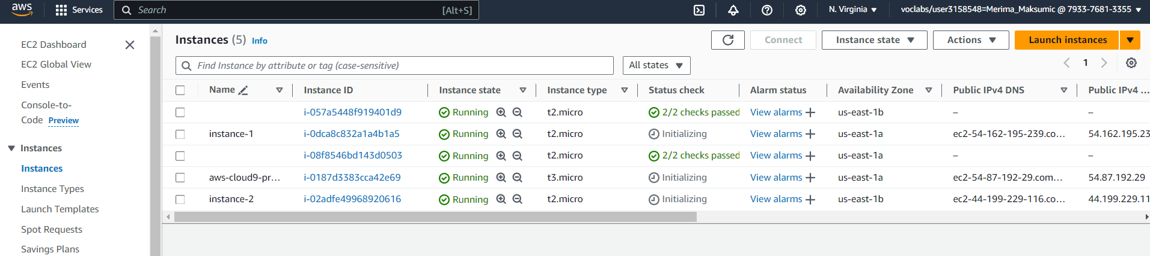
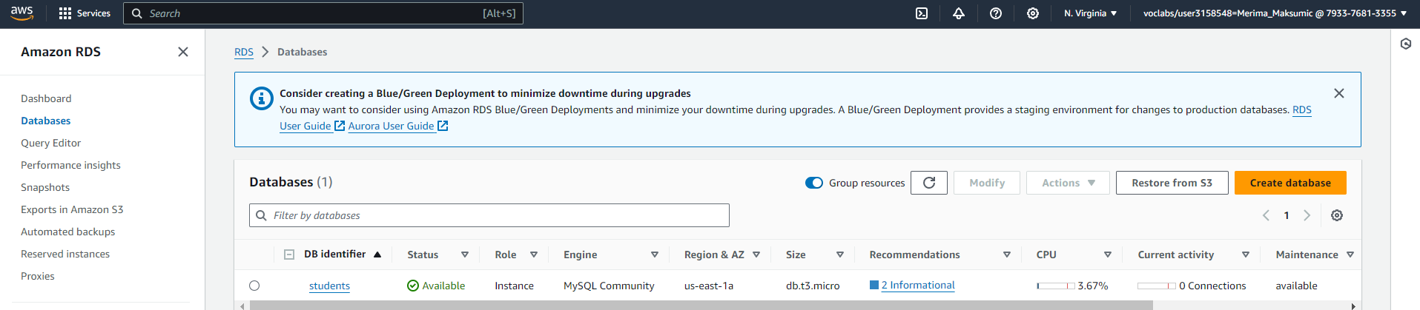

Slide 9
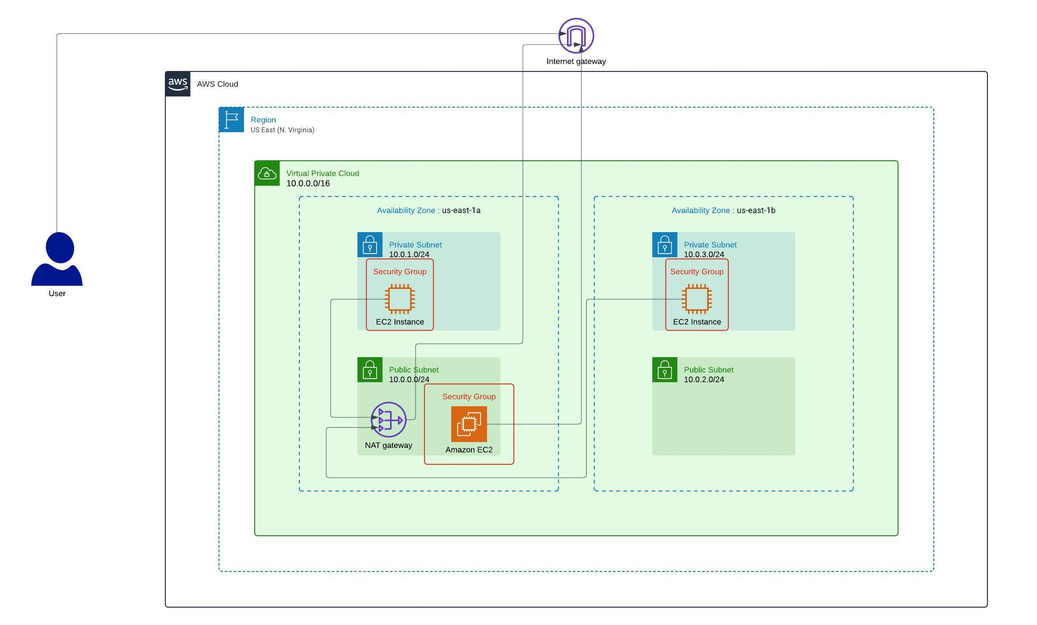
Architecture diagram of the solution : PHASE 2
Notes:
Note: Remove this slide from your final presentation.
This example architecture diagram shows a solution to configure a webhook to link Git with AWS. You can find this example in the Toolkits for PowerPoint at https://aws.amazon.com/architecture/icons.

Slide 10
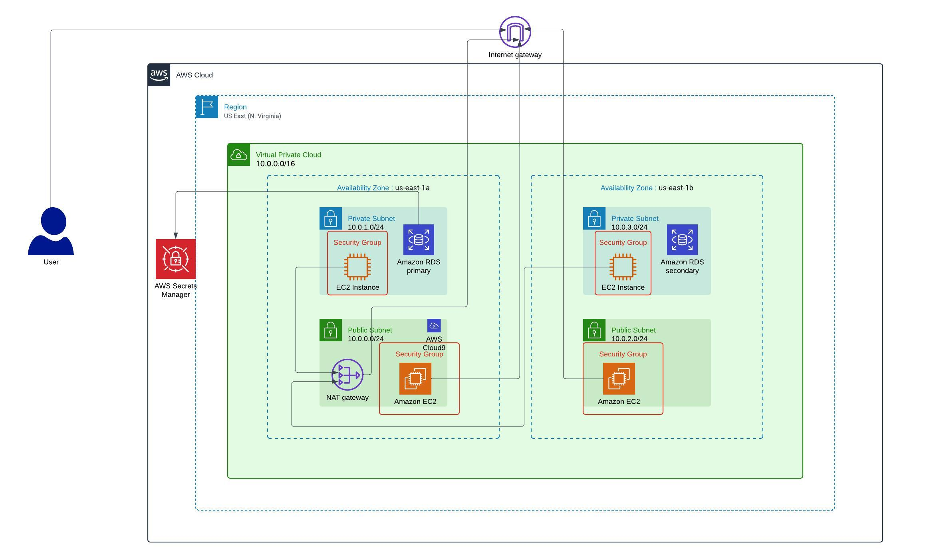
Architecture diagram of the solution : PHASE 3
Notes:
Note: Remove this slide from your final presentation.
This example architecture diagram shows a solution to configure a webhook to link Git with AWS. You can find this example in the Toolkits for PowerPoint at https://aws.amazon.com/architecture/icons.

Slide 11
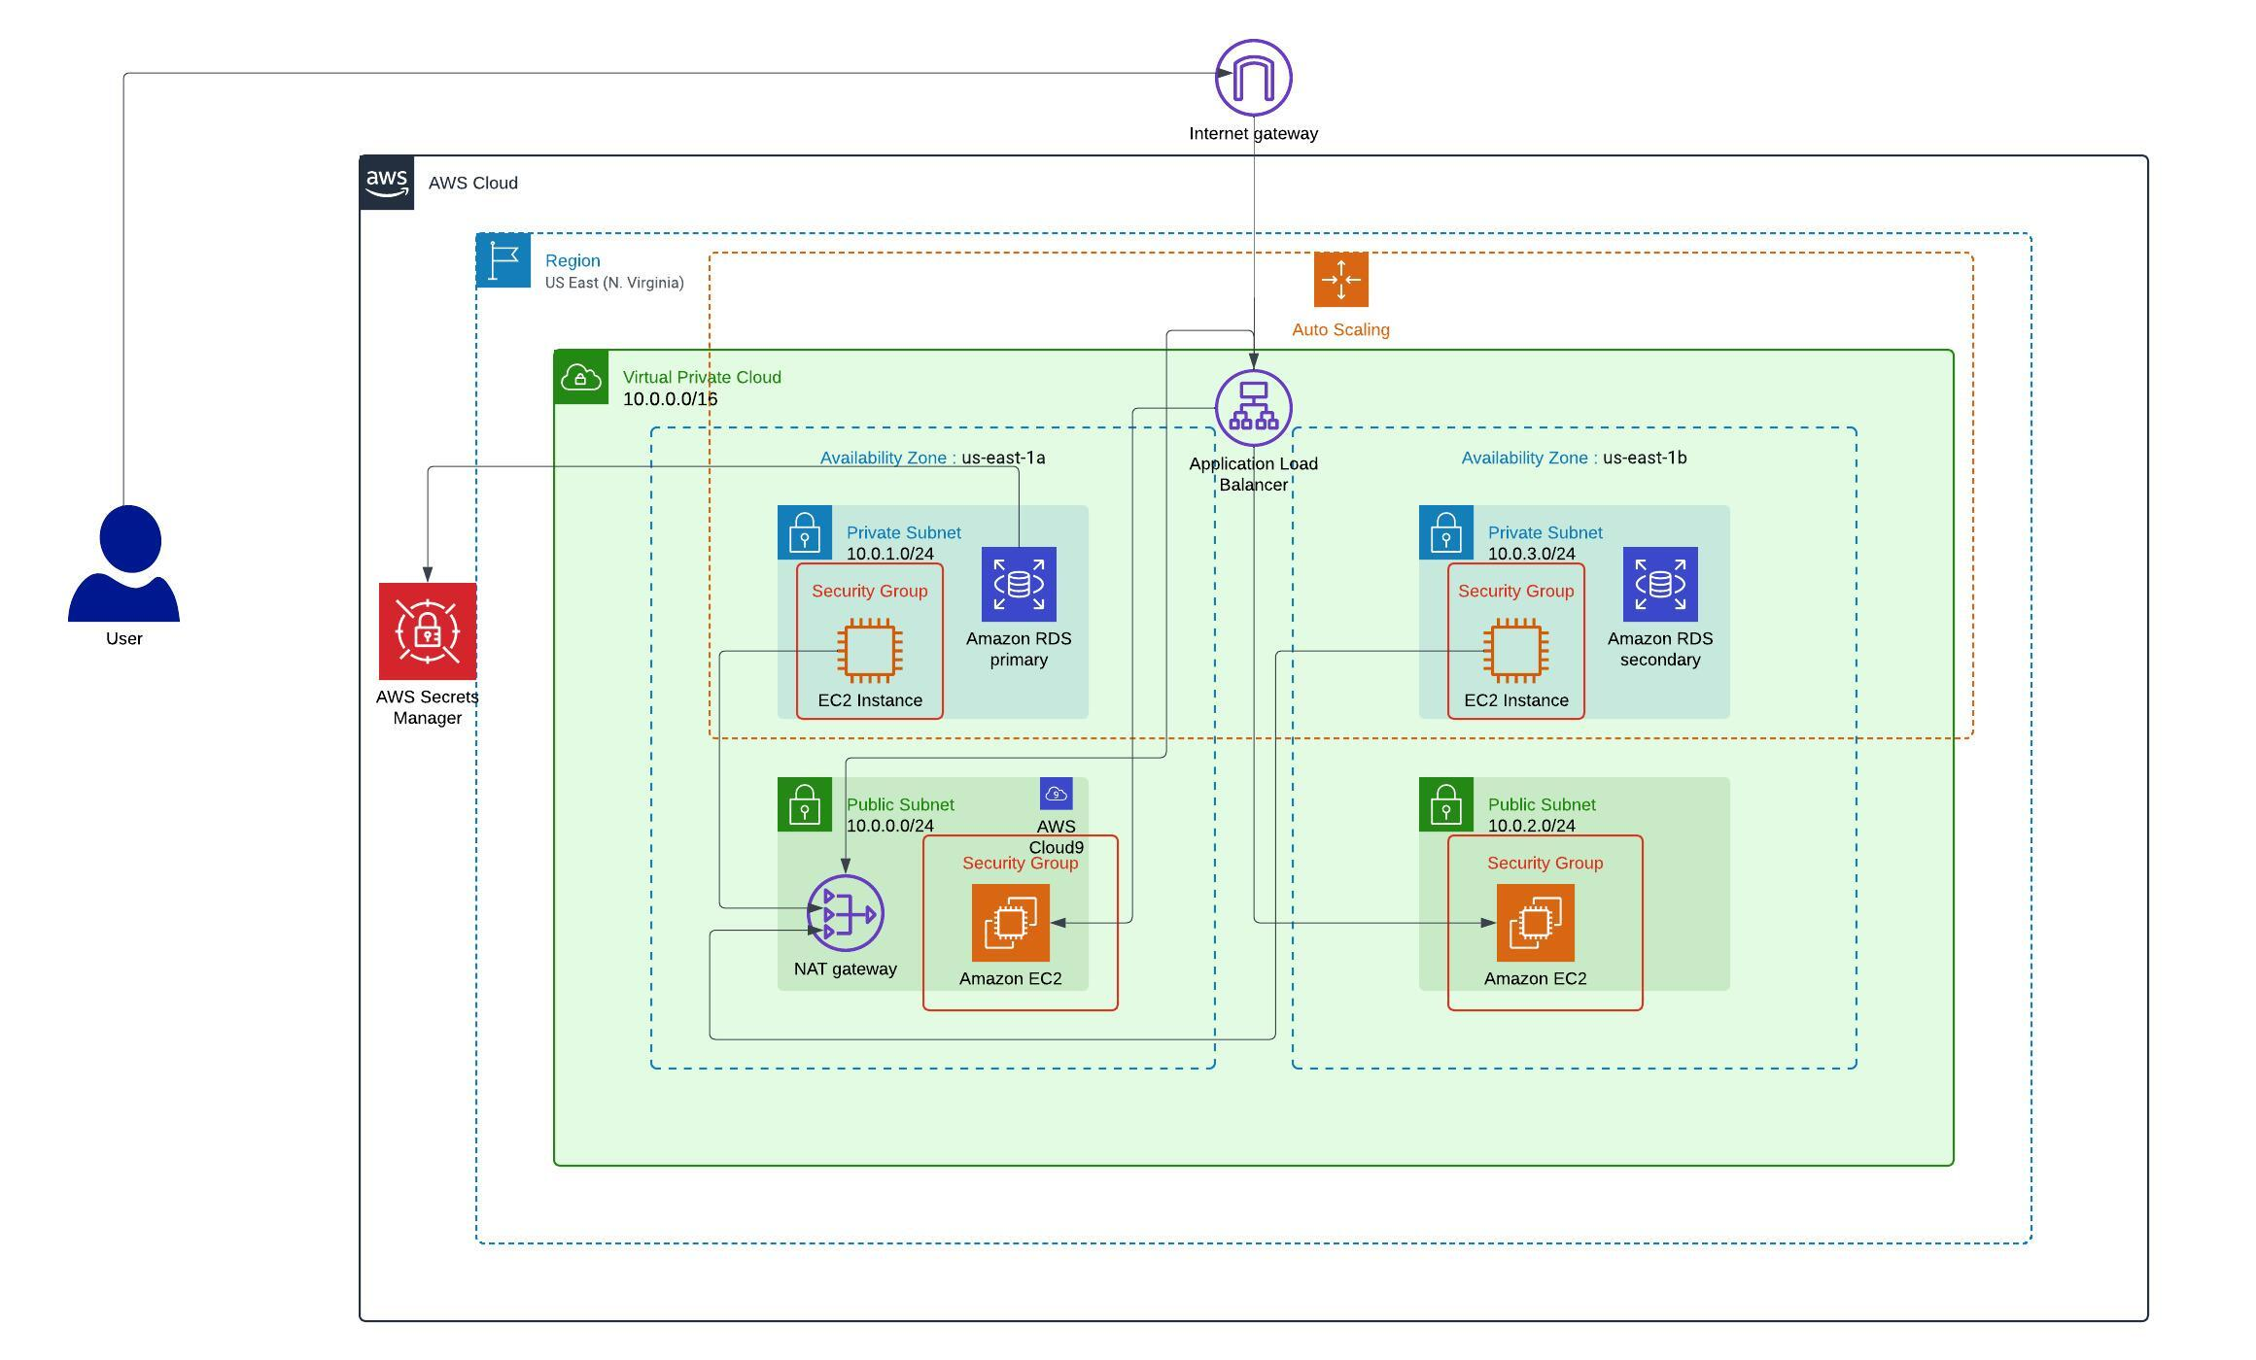
Architecture diagram of the solution : PHASE 4
Notes:
Note: Remove this slide from your final presentation.
This example architecture diagram shows a solution to configure a webhook to link Git with AWS. You can find this example in the Toolkits for PowerPoint at https://aws.amazon.com/architecture/icons.

Slide 12
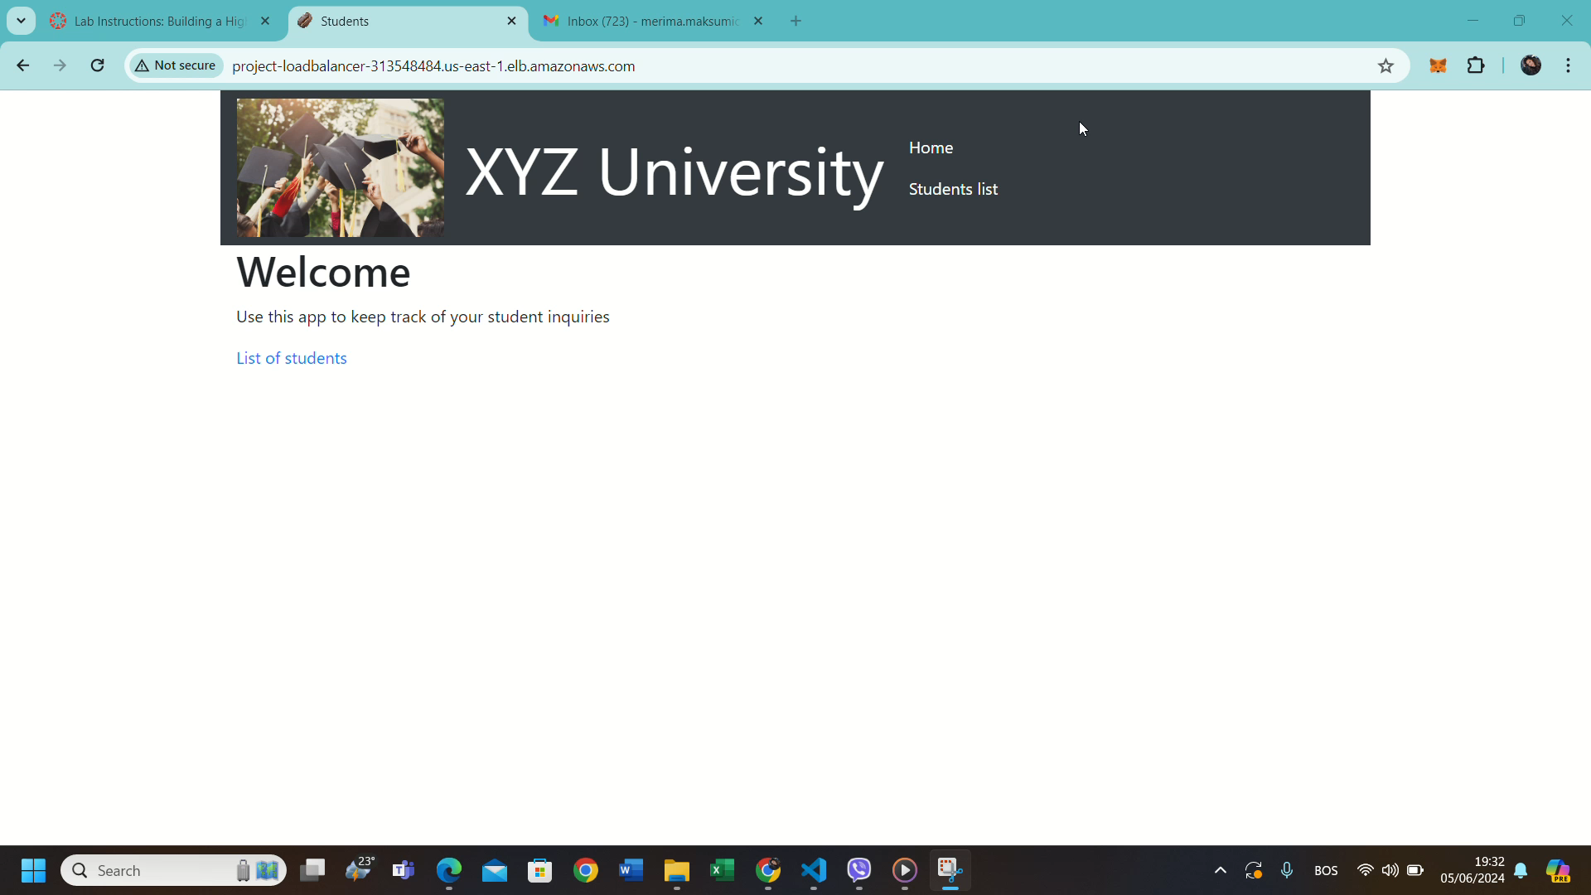
Demo
Notes:
For the demo, guide the audience through the two to three most important benefits of the solution and how it addresses the requirements.
Your demo materials can be screen captures, recordings, or to show AWS console.

Slide 13
Challenges & Lessons learned
Challenges: Migrating data from EC2 to Amazon RDS due to unopened ports. Using the AWS Pricing Calculator and cost estimation were particularly difficult.
Skills Gained:
Separated infrastructure into web server and database.
Enabled auto-scaling and managed instance backups.
Mastered AWS services deployment and pricing estimation.
Phases:
Easiest: PHASE 2 & PHASE 3 - Setting up VPC and EC2 instances.
Most Difficult: PHASE 1 & PHASE 4 -Using AWS Pricing Calculator and migrating data to RDS, which took the most time.
Other: Learn how to write documentation.
Notes:
Describe any challenges that you encountered and how you overcame those challenges.
For example: “I got stuck when I was creating an EC2 instance to host the application. I used the resources that were listed in the instructions to walk myself through the process to create a new EC2, and I was able to complete the task. The links to labs in other courses were very helpful.”
Describe any new skills that you learned from this project.
For example: “I learned how to set up auto scaling correctly so my resources were automatically adjusted and allocated at the lowest possible cost.”
Discuss any future, out-of-scope use cases in the next steps.
For example: “I would like to scale out the web application so that multiple departments can use it.”

Slide 14
References
https://awsacademy.instructure.com/courses/49302/modules/items/4245907 https://docs.aws.amazon.com/pricing-calculator/index.html https://docs.aws.amazon.com/elasticloadbalancing/latest/application/application-load-balancers.html https://awsacademy.instructure.com/courses/49302/modules/items/4246031 https://www.youtube.com/watch?v=aeLdPYGnn_Q https://awsacademy.instructure.com/courses/49302/modules/items/4246271 https://awsacademy.instructure.com/courses/49302/modules/items/4246188
Notes:
Describe any challenges that you encountered and how you overcame those challenges.
For example: “I got stuck when I was creating an EC2 instance to host the application. I used the resources that were listed in the instructions to walk myself through the process to create a new EC2, and I was able to complete the task. The links to labs in other courses were very helpful.”
Describe any new skills that you learned from this project.
For example: “I learned how to set up auto scaling correctly so my resources were automatically adjusted and allocated at the lowest possible cost.”
Discuss any future, out-of-scope use cases in the next steps.
For example: “I would like to scale out the web application so that multiple departments can use it.”

Slide 15

Questions?

Slide 16
THANK YOU!

